Slide 1

Micro Credit Loan Project
Submitted By: NIHAL SINGH

Slide 2
Introduction:
The project is Micro credit model is basically build by the microfinance institution(MFI) that provides financial services to low income populations.
The microfinance services(MFI) provides the group loans, Agricultural loans,indivisual business loans and many more.
Micro Credit model is used to predict the probability for each loan transaction, weather the customer will be paying back the loaned amount within 5 days of insurance of loan.
The model is build by working on multiple models and finalizing the one best model after working on data.
For building the model performing data cleaning, EDA, data preprocessing, model building, hyper parameter tuning and saving the model.

Slide 3
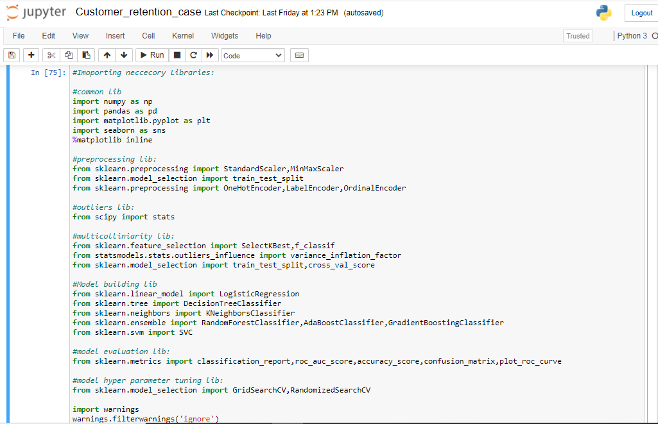
Importing Libraries:
Importing the Libraries used for EDA, data preprocessing and model building.

Slide 4
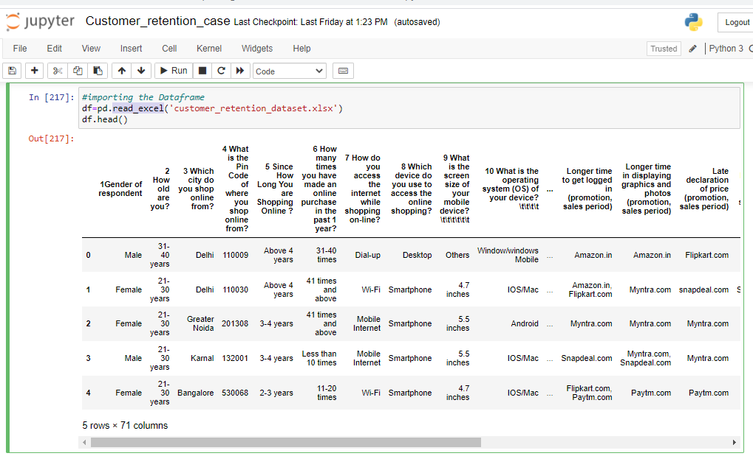
Fetching the Data frame:
Using the pandas library to import the data from excel file to data frame.
The library has been used read_csv.
Using strip in the lambda function to remove the space and unwanted data from
the column of the data frame.

Slide 5
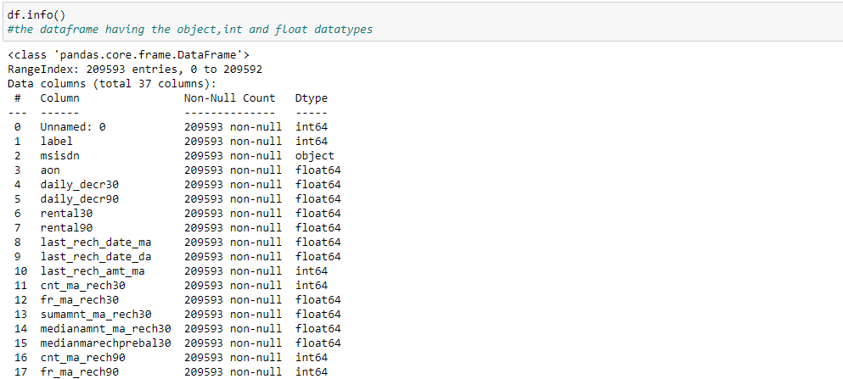
Checking the Shape and info of Data Frame:
Checking the shape of the Data frame using the .shape method.
The shape of the give data frame is (209593,37)
Checking the datatype information about the data frame using the info method.

Slide 6
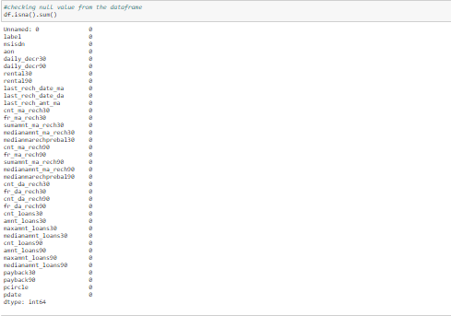
Checking the Null value count in Data frame:
Checking the null value count from every column of data frame.
Using the isnull().sum() method to check the null values. There is no null values in columns.

Slide 7
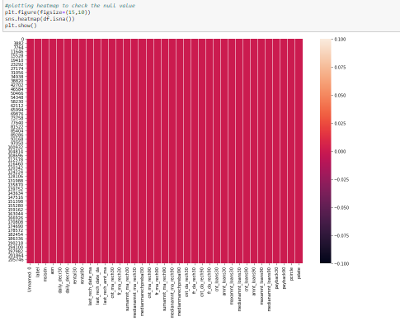
Checking the Null value using Heat map:
Checking the null value count from every column of data frame using the heat map.
Using the seaborn library and using the heat map from the library. There is no null values present in the given data frame.

Slide 8
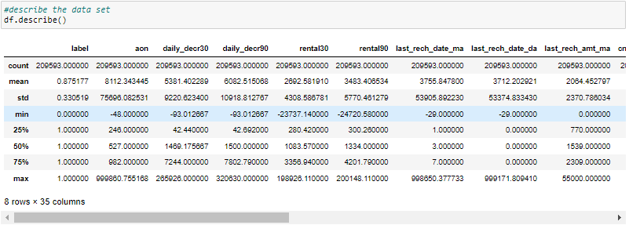
Using Describe Method to describe the data frame:
Using the describe method to describe the numerical columns.Describe method
only work on the numerical data features.
Describe is basically provide the count,mean,standered deviation,min max and quantile details of the columns data.it can be display using df.describe().

Slide 9
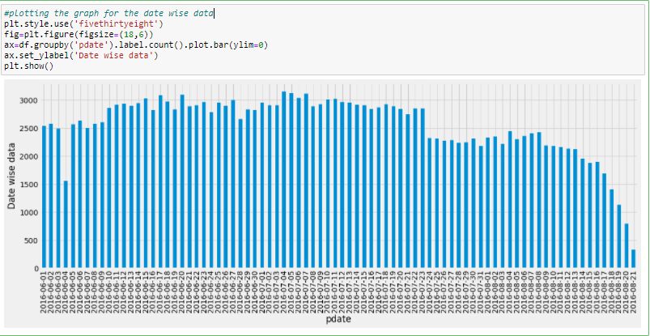
Plotting the Bar Plot:
Using the bar plot to plot to plot the data date wise data in the data frame.
The bar plot shows the date wise data distribution.

Slide 10
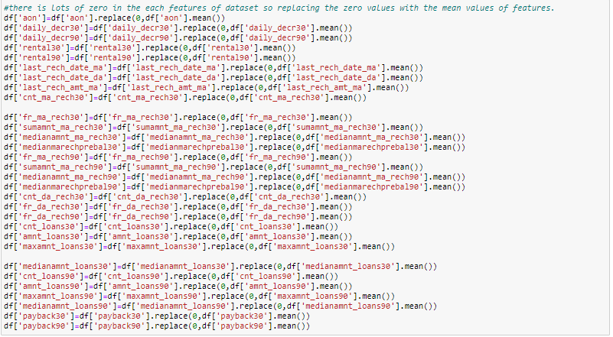
Using the Replace method to fill values:
For many of the features having the max values as zero so replacing the zero values for all the feature with the mean value of the feature values.

Slide 11
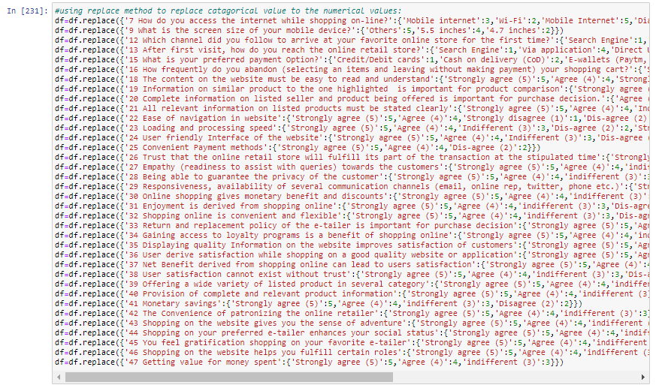
Using the Replace method to replace the data from the features:
Using the replace method to replace the categorical data from feature to numerical values.

Slide 12
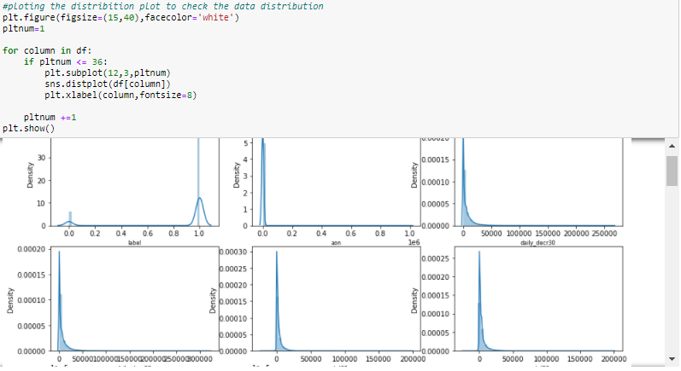
Plotting the Distribution Plot:
After performing the data cleaning and describe the data plotting the dist plot to check the data distribution.
From the dist plot it is observed that there is outliers are available at all the features.

Slide 13
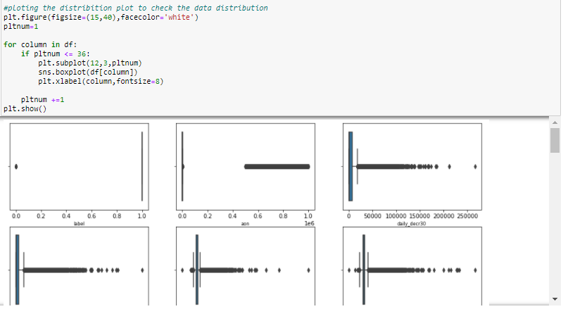
Plotting the Box Plot:
Using box plot to check the outliers in the features of the dataframe.outliers can be easily visible by using the box plot.
The Black dotted lines are the outliers present in the features.

Slide 14
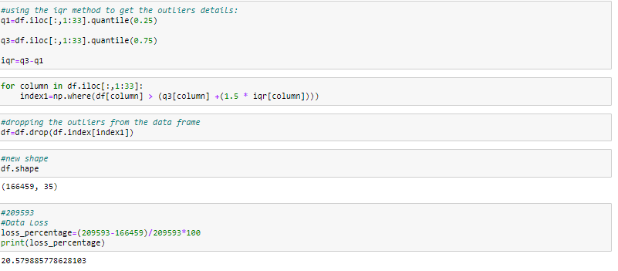
Removing Outliers using IQR:
There are multiple option to check the outliers and then delete the outliers.
The most commonly used method is z-score, IQR and quantile method. For this model using the IQR method.
The 20% data has loss after removing the outliers from the data frame.

Slide 15
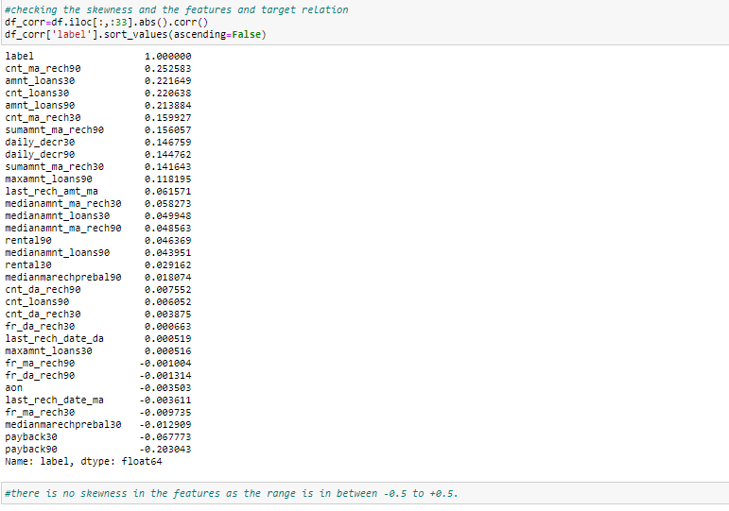
Skewness Removal:
After removal of the outliers, skewness is very important to check and if skewness is present then removal of the skewness.
Max times removal to outliers is automatically remove the skewness in the data.
The range of the skewness is -0.5 to +0.5,if the values are between that then there is no skewness available. Here the range is between that.

Slide 16
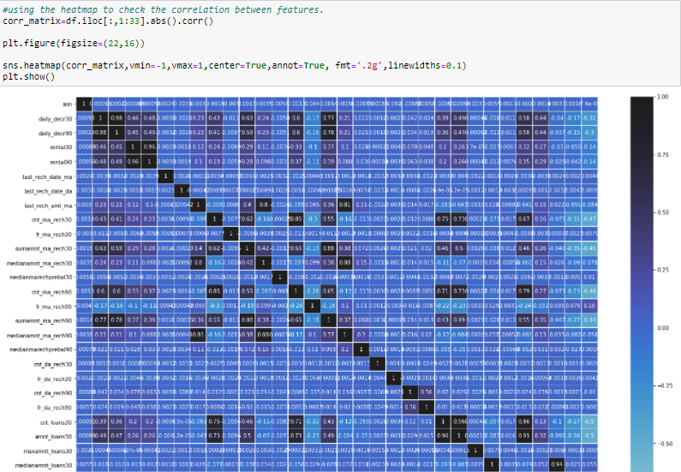
Checking Multicolliniarity Using Heat map:
Multicolliniarity is a problem for a model building.it shows relation between feature to feature. If the score is high then the features are highly collinear to each other.
Checking the multicolliniarity problem using heat map.

Slide 17
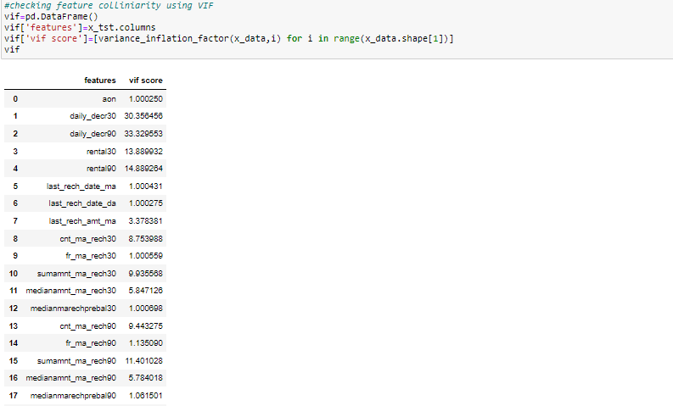
Checking Multicolliniarity Using VIF:
Checking the multicolliniarity issue with the help of variance inflection factor as we can see there is multicolliniarity issue using the heat map.
VIF provide the VIF score, if the score is greater than 5 then there is issue of multicolliniarity.

Slide 18
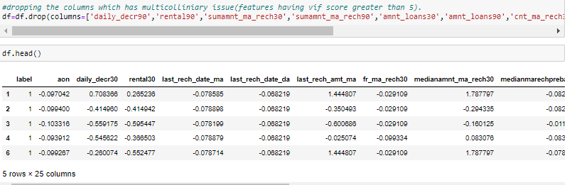
Removing column having multicolliniarity issue and Scaling the features:
Removing the columns from the data frame having multicolliniarity issue getting from the vif score.
Scaling the data after removing the features form vif score. Scaling is most important part in model building as after scaling data came to the same range.
Using the standard scalar to scale the data.

Slide 19
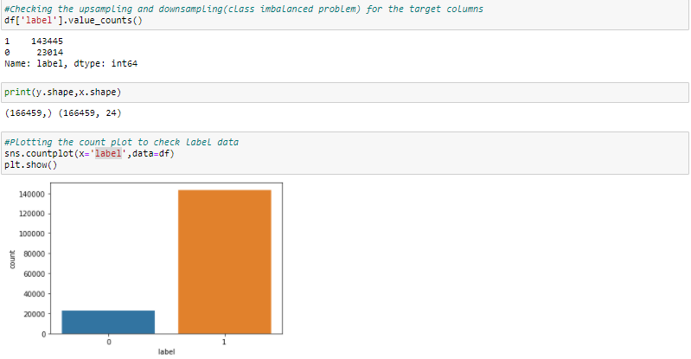
Separating the feature and target to build the model:
Separating the target and features variable in x and y variable to build the model.
It is a classification model as target variable having only two outcomes.

Slide 20
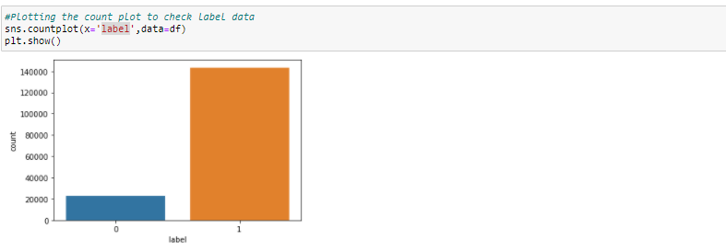
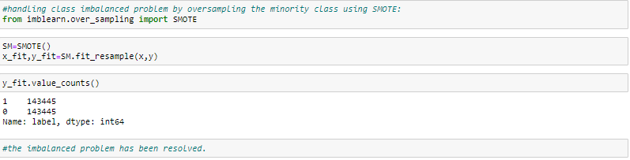
Checking Class imbalanced:
Class imbalanced issue occurs in classification model if the target variable having the imbalanced data.
Model having the class imbalanced issue so performing the up sampling to solve the class imbalanced issue.
Up sampling can be performed using the SMOTE.
.

Slide 21
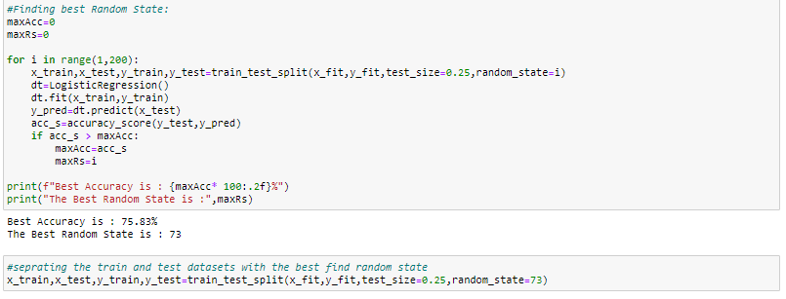
Training the model and finding the best random state:
After the EDA and data preprocessing training the model and finding the best random state using the train test split.
The training the model into x_train, y_train, x_test and y_test.

Slide 22
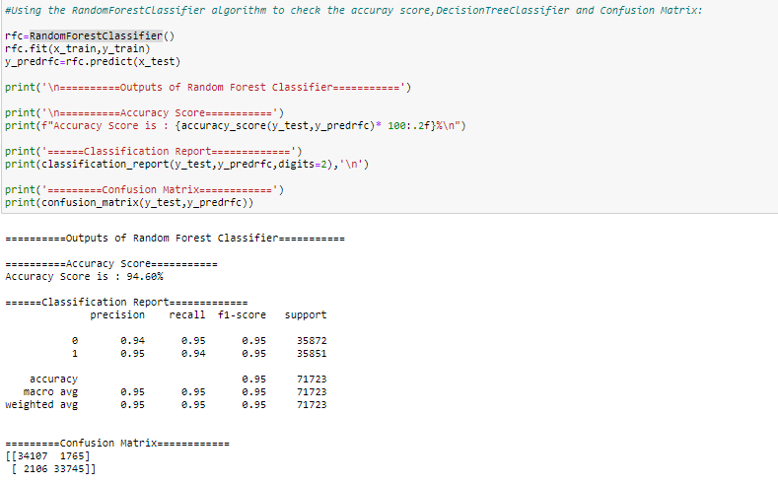
Building the multiple Models:
After the test_train_split, building the model using the test data.
Building all the classification models like LogisticRegression , DecisionTreeClassifier, AdaBoostClassifier, RandomForestClassifier, KNeighborsClassifier.
Training all the classification on train and test data and finding the accuracy.

Slide 23
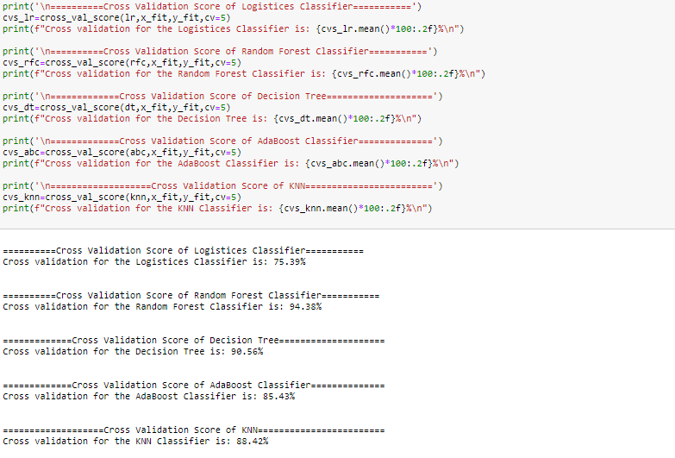
Performing Cross validation score:
After building the multiple models and getting the accuracy performing the cross validation score on all the models.
Cross validation is basically used to check the model is under fitting or over fitting on the test data.

Slide 24
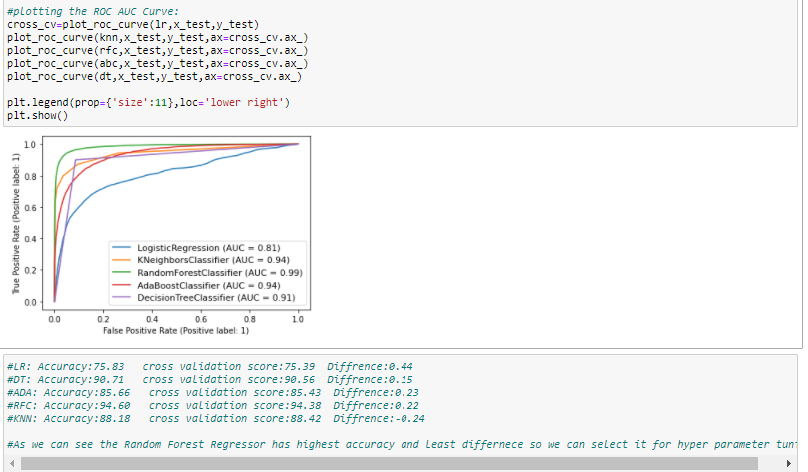
Plotting ROC AUC Curve:
Plotting the ROC AUC Curve for all the model to select the best model for the hyper parameter tuning.

Slide 25
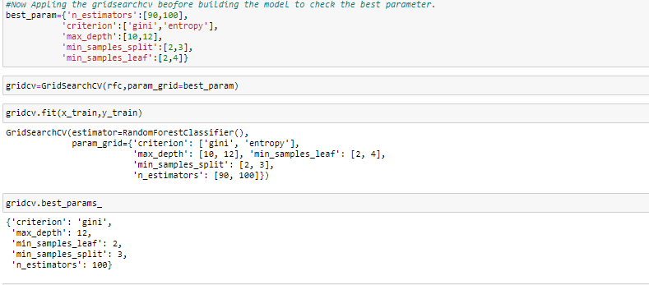
Hyper Parameter Tuning:
Selecting Random forest classifier as a best model as it has highest accuracy and least difference between accuracy and cross validation score.
Hyper parameter tuning having multiple parameters and selecting the best parameter for the model.

Slide 26
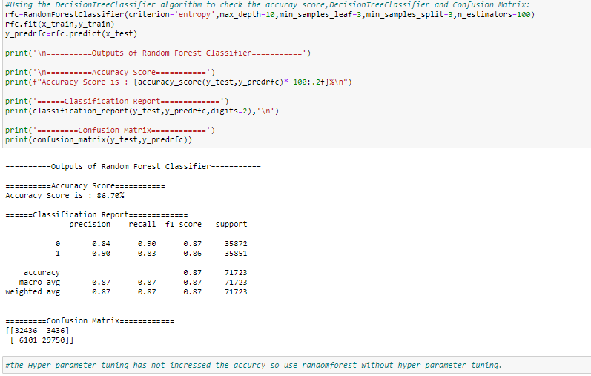
Training the model after Hyper parameter tuning:
Training the model again after the hyper parameter tuning and providing the best parameter values to the model gets from the hyper parameter tuning.

Slide 27
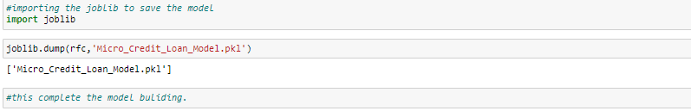
Saving the Model:
After the hyper parameter tuning saving the final model in the pkl file.
This complete the model building.

